Slide 1
Holding Company LLC
LLC 1
(Business)
LLC 2
(Rental Property)
LLC 3
(Business #2 or Rental)
What is best business set up?
Cost to have above setup, vs multiple separate LLC’s?
Is there a breakover where the above makes sense? Revenue target etc?
Does the above make paperwork or anything else easier/more streamlined?
Is it possible to move already existing LLC’s into this set up in the future?

Slide 2
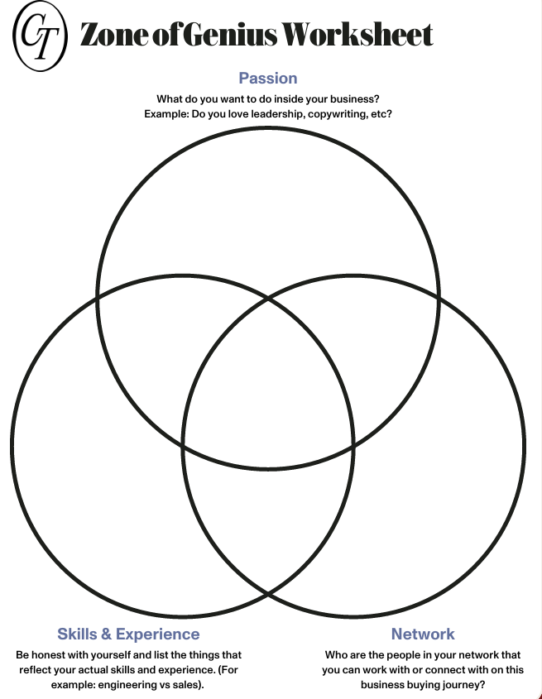
Building Things
Fixing things
Being outdoors
Spending time with family in experiences
Zone of Genius
Passion
Project Management
SIMOPS
Operations
Analytical
Process Improvement
Systems/Process Design
Private Money – Friends/Family
BIL – Handyman
BIL – Physical Therapist
SIL – Nurses/Doctor
Friends – Business owners/salesmen
Skills and Experience
Network

